Slide 1
Measuring ROI of IT Security Investment Security Metrics Gerhard Steinke

Slide 2
Which organization is the most or least secure?
Large bank
Telephone Company
Visa or MasterCard
University
Your organization

Slide 3
What platform is the most or least secure?
Windows or Linux?
Network devices?
Apple or Samsung phone?
Cloud provider?

Slide 4
The Need for Scores
Financial losses from security incidents
Security resources allocated on first-come, first-served basis – event-driven
Increased regulations
Want oversight
Benefit of spending more money on security?
Executives are held responsible

Slide 5
Foundation of Risk
Balance technology, people, and process to extract the greatest value from security investments
Evaluate assets based on importance
Identify threats against assets
Determine the vulnerabilities' that take advantage of those threats
Risk = Asset Value x Vulnerability x Threat

Slide 6
Problem
How secure is your organization?
How secure does your organization need to be?
How do you define “good” security?
What is the difference between “strong” security and being lucky?
How do you measure success?
What is measurable?
Benchmark security?
One incident doesn’t necessarily mean failure…

Slide 7
Why Metrics?
Metrics help define “secure”
Metrics let us benchmark our security investments against other organizations
Metrics check for compliance
Metrics determine efficiency and effectiveness of funds
The metrics “gathering” process often leads to identification of security inconsistencies or holes

Slide 8
Successful IT Security
No incidents?
Justify budgets
Justify budgets with ROI
Measure progress to performance goals
Increased spending should lead to improved performance and decrease in risk!

Slide 9
Using Metrics
Manager asks, “Are we secure? Have the changes that we implemented improved our security posture?”
Without metrics: “Well that depends on how you look at it.”
With metrics: “No doubt about it. Look at our risk score before we implemented that firewall project. It’s down 10 points. We are definitely more secure today than we were before.”
What can't be measured can't be effectively managed

Slide 10
Security Metrics will:
Enable organization to set and design program to achieve a quantified security goal
Evaluate maturity of security program
Allow comparison with management expectations
Enable comparison to regulatory requirements or standards
Enable benchmarking with other organizations
Track progress to goal

Slide 11
Finding Easy Security Metrics
Choose an initial set of security effectiveness metrics which
Can be assembled quickly
Demonstrate impact
Add harder-to-capture metrics later

Slide 12
Standard IT Metrics
Financial Market Cap Overall Revenue/Funding level Overall Expenses Workforce Number of Employees Number of contractors/temps Number of locations with dedicated IT IT Spending Budgets for Operations, Maintenance, Capital, Employees Equipment Count of Servers, appliances, databases, client PCs, Laptops, PDAs Network Traffic Count of flows, possible flows, actual flows, blocked flows, sessions, commands, transactions Security Spending Operations, Maintenance, Capital Expenditures, Number of Security FTEs

Slide 13
More Standard IT Metrics
Identity Management Management budget Management FTEs Total User Repositories Total User Accounts Count of user accounts created, accounts modified, password resets, accounts disabled/deleted Authentication Events Number of failed authentications Vulnerability Management Spending Number of servers/applications/PCs scanned Number of Vulnerability Management FTEs Count of open ports, known vulnerabilities, patches, configuration changes Trust Management spending Count of Trust Management FTEs, policies written, certificates issued, signed documents, encrypted documents Threat Management Spending Count of Threat Management FTEs, alerts, compromised systems

Slide 14
Security Metric Categories
Platform
Number of servers that are compliant with policy
Network
DMZ port scans
Incident
Number of hosts infected with worm XYZ
Vendor
Average security rating for vendors that touch active customer files
People
Number of terminated employees with administrator access
Industry
Number of public security incidents in sector ABC with severity score Z
Political
Hacking scores, amount of sites listing sector/company ABC as potential target

Slide 15
Security Metric Types
Real Time
Number of concurrent connections to VPN
Something from incident response systems
Polled
Number of password reset requests
Usually from SA’s
Incident based
Number of machines infected with worm XYZ
Number of vendors suffering from infections of worm XYZ
Usually from industry intelligence/incident response/SA’s

Slide 16
Qualitative vs. Quantitative
Qualitative
Soft measurements
Subjective
Reactive
Quantitative
Numerical measurements
Calculated
Proactive

Slide 17
Quantitative Approach
Pros | Cons
Results based on objective measurements | Calculations can be complex
Monetary value is assigned to risk and security measurements | Significant upfront time and effort required to assign risk ratings to assets
Comparisons of security posture over time can be calculated | Industry standards for risk and return have not yet been set
Resources can be dedicated to high risk areas | Ongoing efforts required to track and update risk ratings
Return on investment on security solutions can be measured

Slide 18
Qualitative Approach
Pros | Cons
Easy calculations, if any | Results are purely subjective
Monetary value does not have to be used | Resources can be deployed in the wrong area
Measuring threats and countermeasures is not necessary | No way to calculate monetary value of implementing security measures and results
Generalizations about risk can be made and acted upon quickly | Cannot analyze cost / benefits
 | Cannot analyze business impact

Slide 19
How are metrics collected?
Data collection should be
Accurate
Consistent
People understand purpose
Part of normal work flow
Add little unnecessary reporting overhead
Categorize and define the metric and its owner
Determine and document metric source
Automated
database connection
Script file output
Manual
Email polling
Form entry
Manual file updating
Report analysis/research

Slide 20
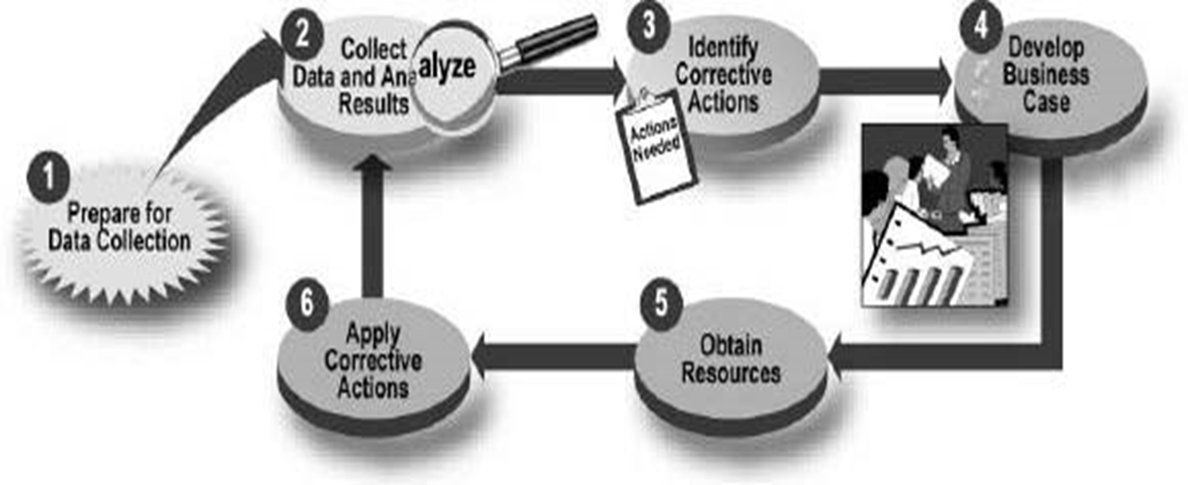
Metric Implementation Process
Purpose
Describe overall functionality obtained by collecting the metric.
Performance Goal
State the desired results these security control objectives/techniques that are measured by the metric
Frequency
Propose time periods for collection of data that is used for measuring changes over time.
Formula
Describe the calculation to be performed that results in a numeric expression of a metric.
Data Source
List the location of the data to be used in calculating the metric.

Slide 21
Displaying Metrics
Using colors – red, yellow, green
Graphs, pie charts
Comparison to previous time period or benchmark
Focus on high risk areas
Reports and systems that are easy for auditors to use.
Meaningful and provable risk scores with metrics
Higher bar for competition means they spend more time/money/effort complying

Slide 22
Metrics used in Organizations Today (Robert Frances Group in CSO Magazine)
Metric | % using
Viruses detected in user files | 92.3%
Invalid logins – failed password | 84.6%
Intrusion attempts | 84.6%
Spam detected/filtered | 76.9%
Unauthorized website access | 69.2%
Invalid login – failed username | 69.2%
Unauthorized access attempts (internal) | 61.5%
Admin violations (unauthorized changes) | 61.5%
Intrusion successes | 53.8%
Unauthorized information disclosures | 38.5%
Spam not detected (missed) | 38.5%
Spam false positives | 30.8%
.

Slide 23
Security Assessments and Testing
Percentage of total systems with current security plans
Percentage of total systems that have a contingency plan
Percentage of total systems that had formal risk assessments
Percentage of total systems for which security controls have been tested during past year
Percentage of total systems that undergone security testing and risk management
Percentage of total systems for which contingency plans have been tested in the past year

Slide 24
Other Security Metrics
Percentage of employees with security responsibilities and have received security training during the last year
Percentage of agency with incident response plans
Number of incidents reported to law enforcement

Slide 25
Testing Levels for Compliance
Differs for areas within organizations
Different platforms
Use of levels
Espiria suggests 5 levels
Need description or measurement criteria for each level for every criteria
Middle represents appropriate and attainable level of compliance

Slide 26
Measurement against Standards Levels of Security (from Espiria)
4-5: Advanced Security
Acute risk and loss potential; advanced security program; exceeds standards of good practice
3-4: Comprehensive Security (Enterprise Focus)
Regulatory compliance issues, material risk; maintained and managed security program; meets standards of good practice
2-3: General Security
Measurable risk associated with data and systems; meets minimum standards of due care
1-2: Technology Centric Security (IT Focus)
Moderate risk, important data, financial exposure; basic security process and technology deployed
0-1: Minimal Security
Smaller organization, public data, low risk; based process includes minimal security process and controls

Slide 27
Physical Access Control
0 – Limited physical access control to facility
1 – Minimal physical access control, public facility, internal doors may have key lock
2 – ID badge or staffed reception area, locked after normal work hours
3 – ID badge and staffed reception area, locked internal entry, video recording
4 – mandatory ID badges with PIN or biometrics, access is logged, doors always locked
5 – mandatory photograph baring ID with PIN or biometric, armed guards, metal detectors, closed circuit cameras

Slide 28
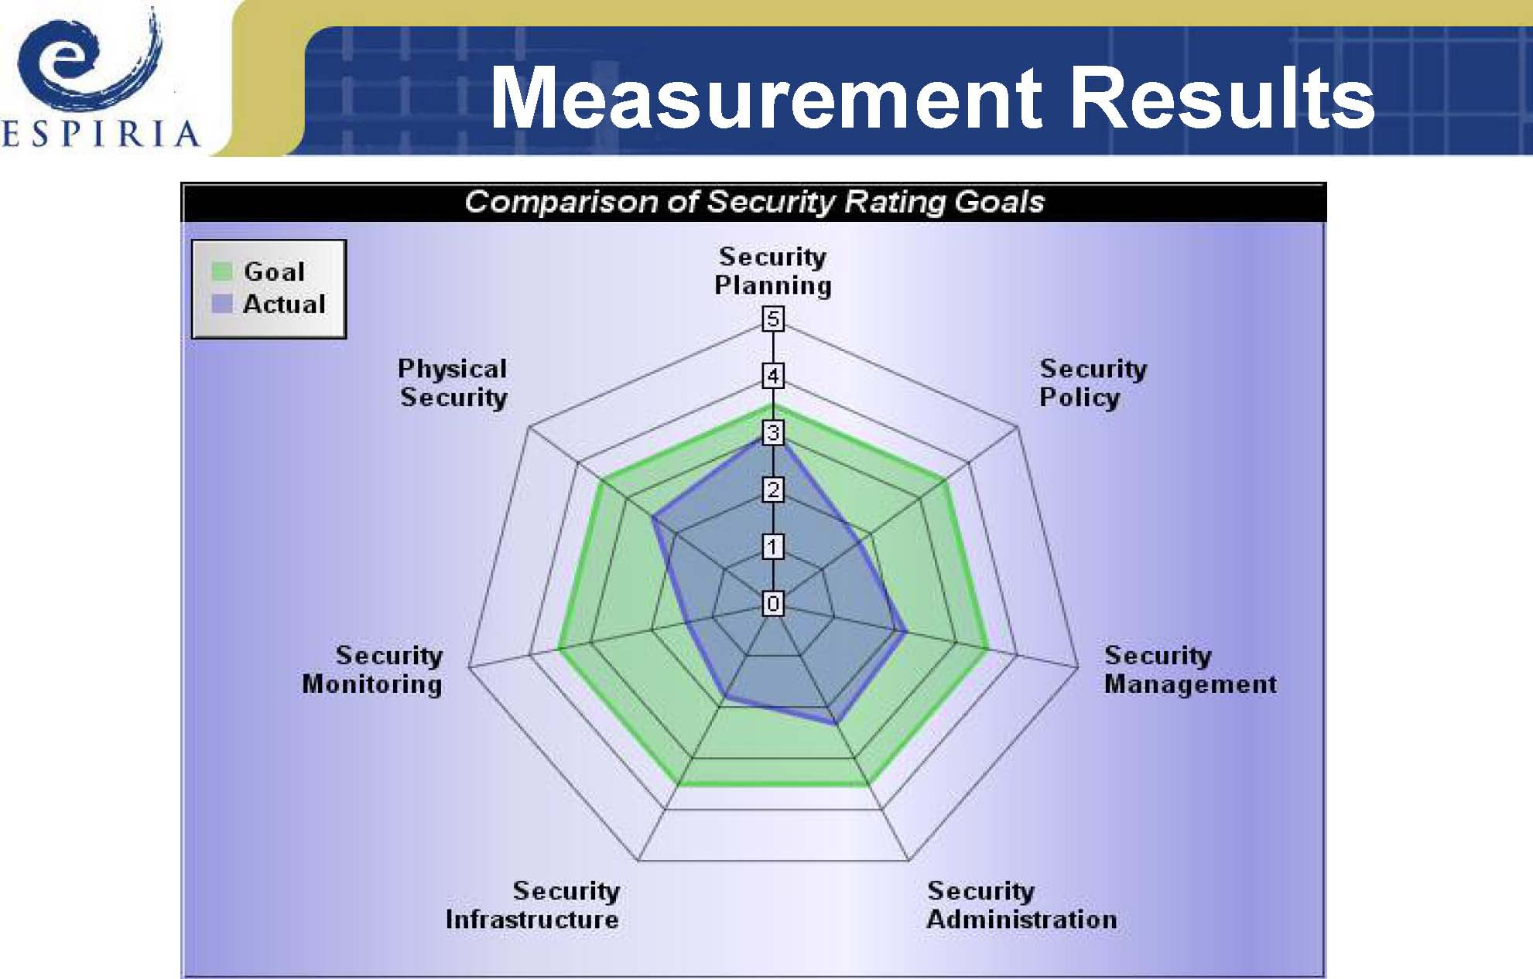

Slide 29
Defining Security Levels
What is good in one industry may not be good in another
Good practice evolves over time
Measurement systems need to evolve over time

Slide 30
SecurCompass Results
350 companies
Average security measurement was 1.8
Military organization was 4.4
Majority in 1 to 2.5 range
Security measurement was lower than management expected
Yet goal was always higher than security program was
Only 7% of measured organizations met all security controls defined by appropriate standard

Slide 31
Results by Industry
Financial industry generally more compliant
Retail industry least compliant
Education and health care were low
Helps determine “due care” or reasonable precautions
What is normal for similar organizations

Slide 32
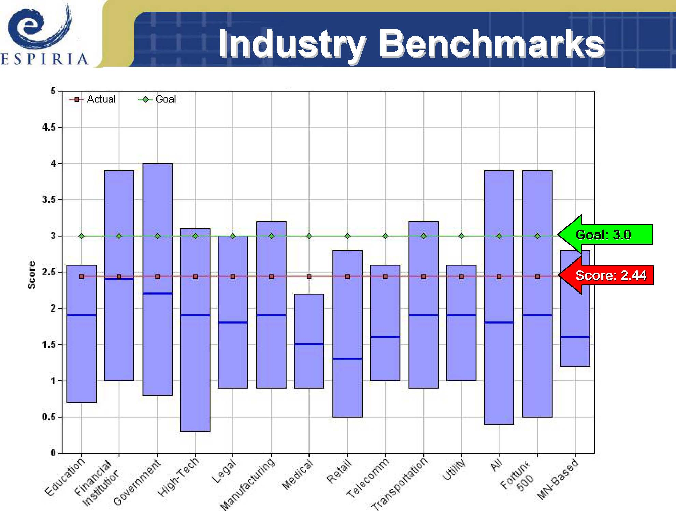
.

Slide 33
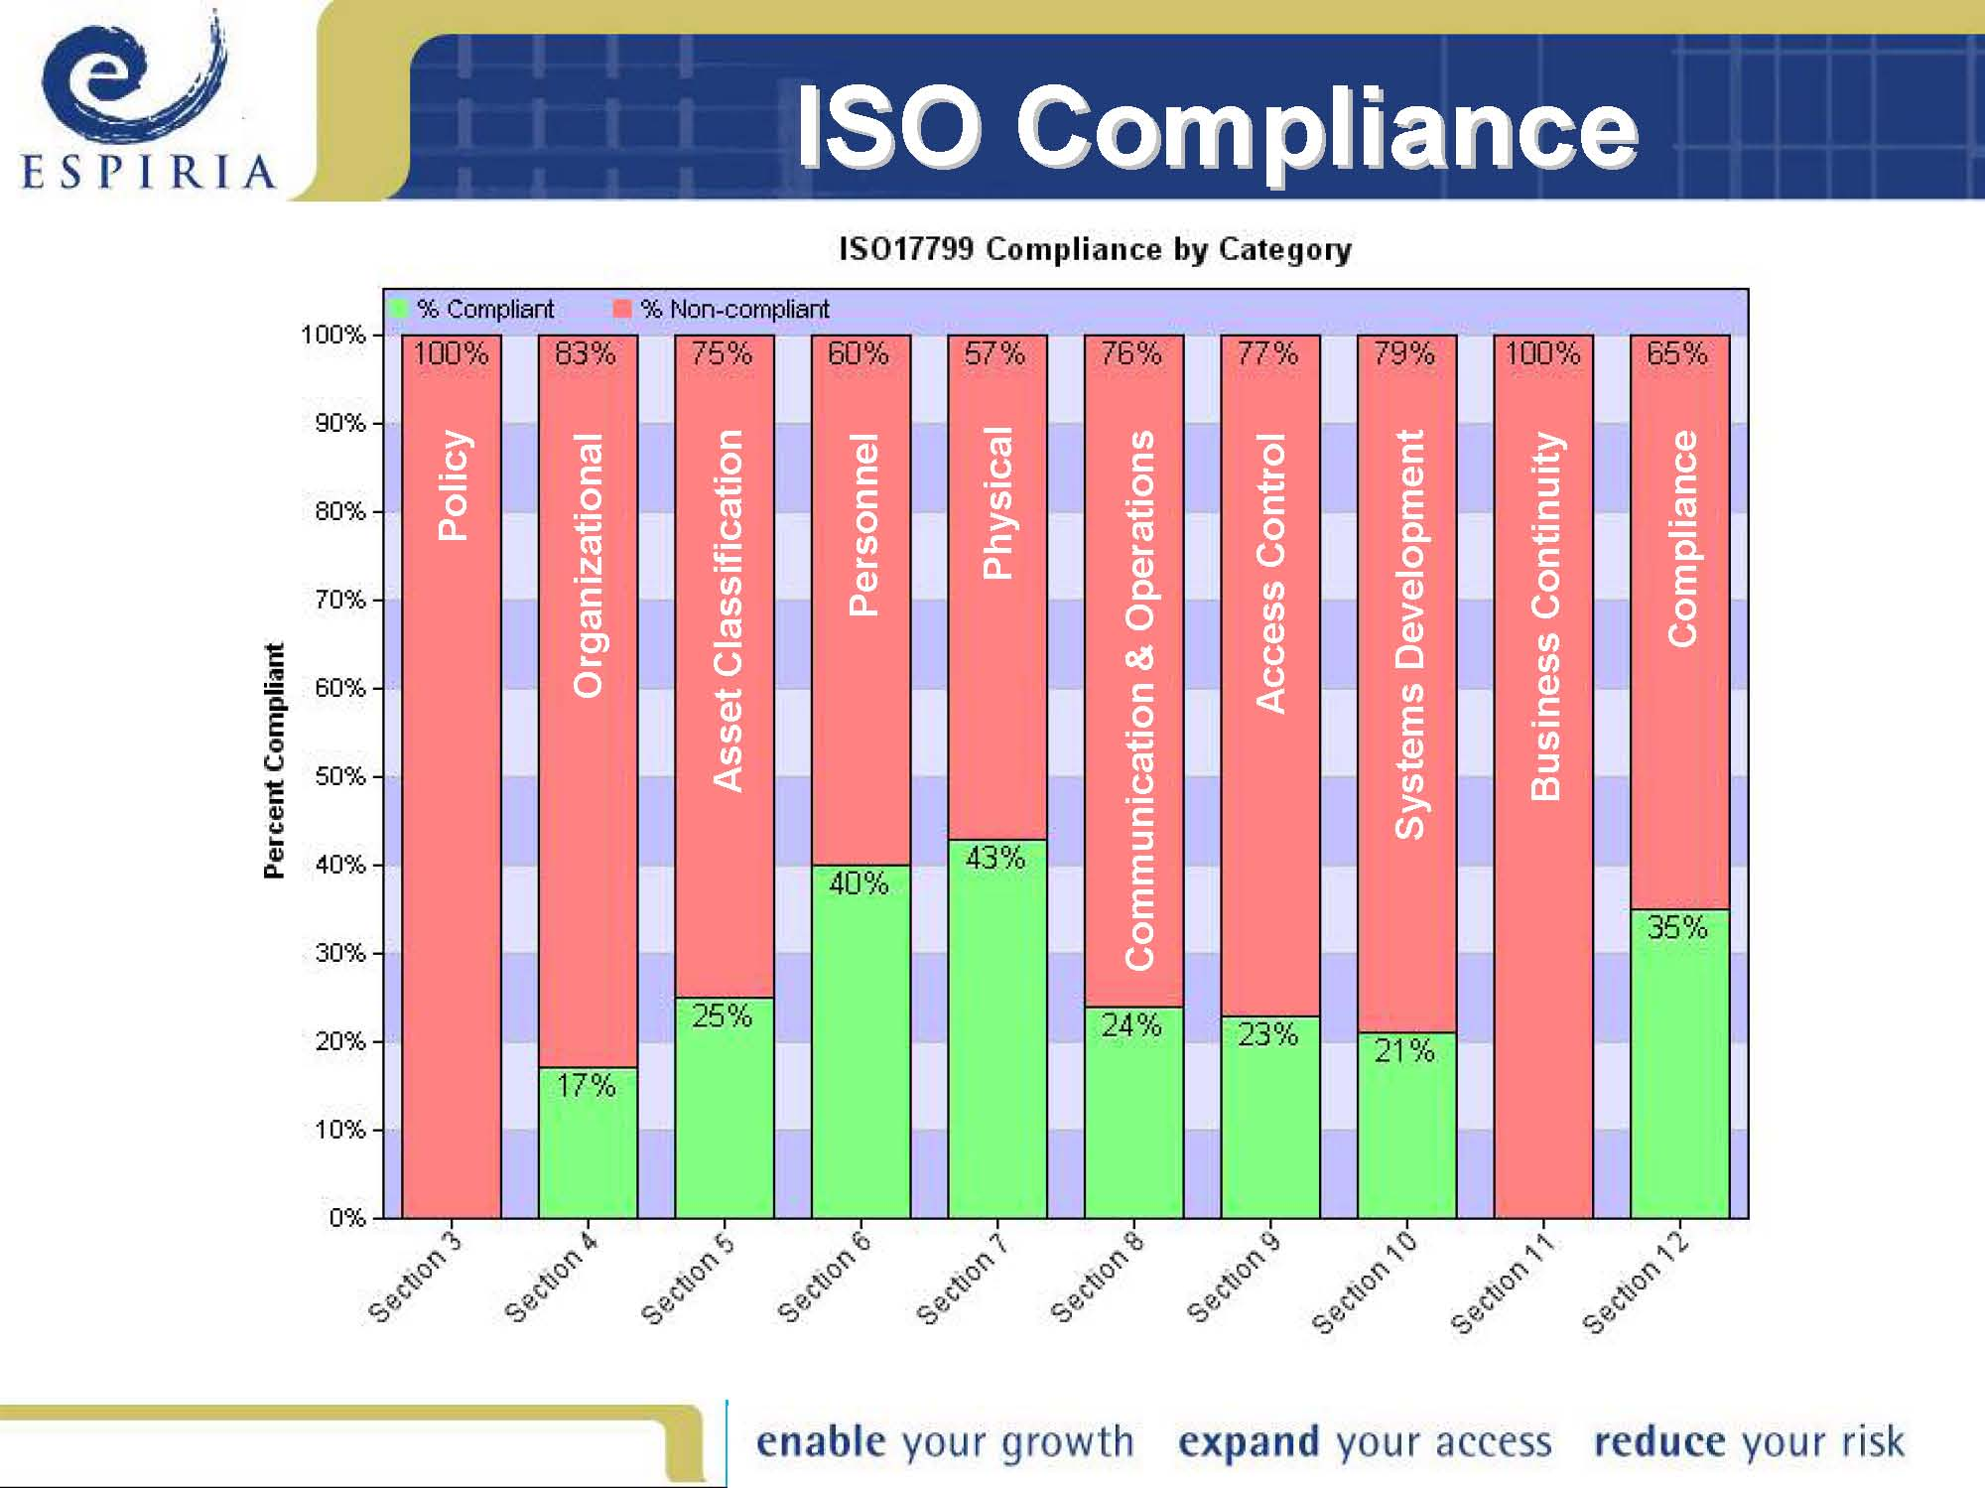
.

Slide 34
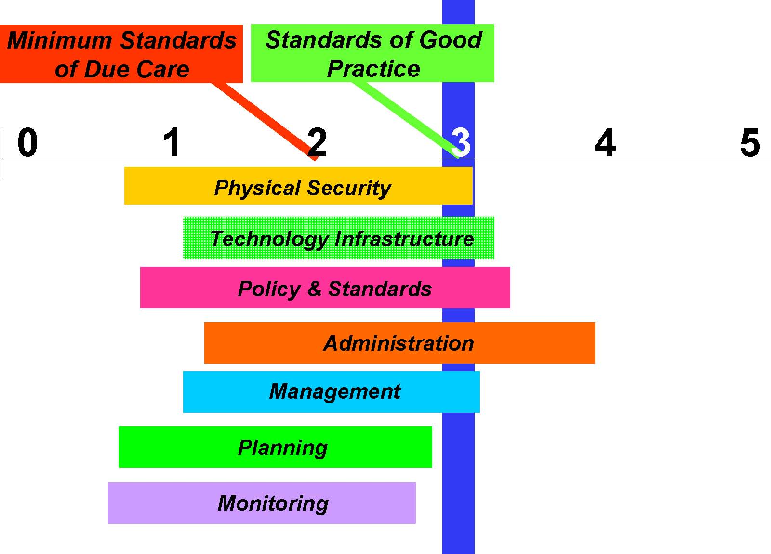
.

Slide 35
Results compared to Security Spending
If organization spends more, improvement in security level is expected
Dependent on industry and size of organization
Dependent on initial score
No spending may result in lower score as expectations rise
Would like a cost per point increase…

Slide 36
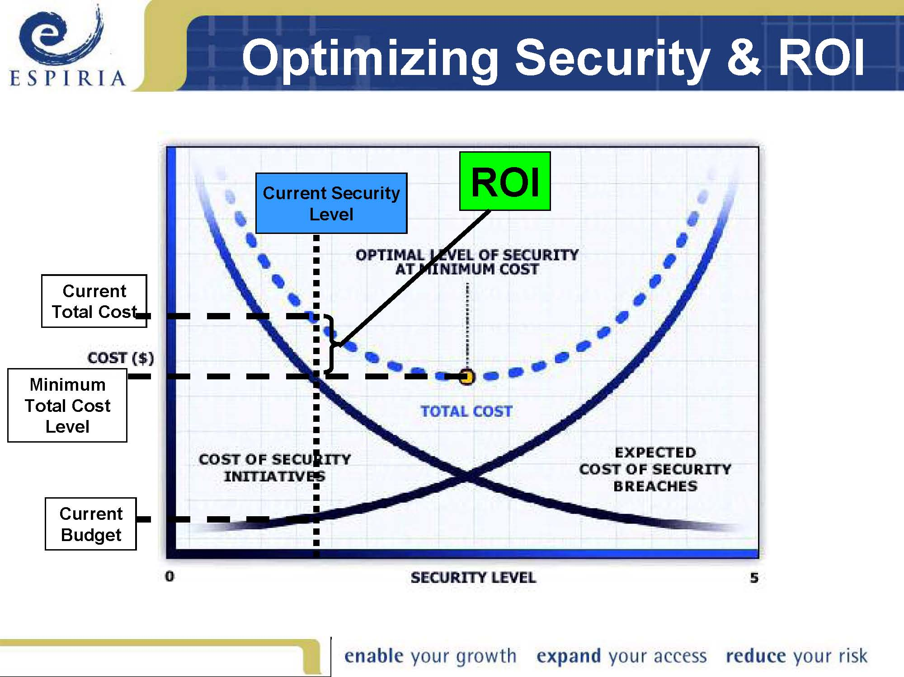
.

Slide 37
Security ROI – Is it Possible?
Yes!
Object is to reduce risk and lower total cost
Measurement and program design is the key
Identify and quantify risks
Establish a security goal based on the risks
Measure current security level and identify gaps
Develop a plan to close the gaps and reach the goal
Re-measure and track progress over time

Slide 38
Use Metrics
Can’t improve security until you measure it
Security is a business operation
Therefore run like a business operation
Provides information security credibility
Improved intelligence about information security, risk and security initiatives will help organizations make smarter information security investments

Slide 39
Security Measurement
Ability to establish quantified security goals
Ability to evaluate security program status against goals
Ability to design security program to meet goals over time
Ability to track security program implementation
Benchmark information related by industry
Quantitative return on investment metrics

Slide 40
Challenges
Keeping up with a moving target
Attaining industry data
Tracking scores over time
Time to inventory client assets
Difficulty assigning monetary value
Others?

Slide 41
Assignment
Pretend you are a security analyst at a large bookstore. You have just had the following (highly simplified and fictitious) conversation with a senior manager.
Manager: “Another bookstore was just sued because customer’s account could be accessed by anyone online. How secure is our new server?”
You: “We believe the new design is secure, however, haven’t allocated time, money and effort to a post-implementation security evaluation.
Manager: “I need to show the board that we are not prone to this type of humiliation, what can you pull together for me in the next 3 months?”

Slide 42
Your assignment is to describe how you would structure your new metrics proposal which includes the following sections.
Description of which metrics you will be collecting (Based on risk analysis. Remember, this should be a minimal set, you only have 3 months to set this up)
A metric collection process example for one of the metrics
Suggested, simple weighting of metrics to calculate the overall risk score of the system.

